Slide 1
3D Computer Vision
Dr. Hassan Foroosh
School of EECS
UCF

Slide 2
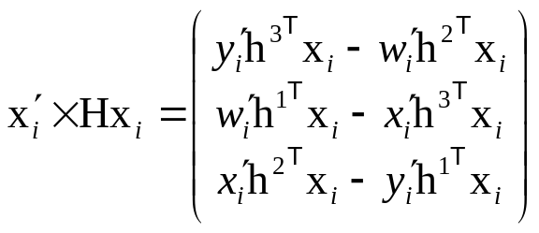

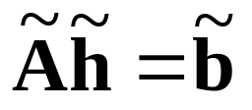
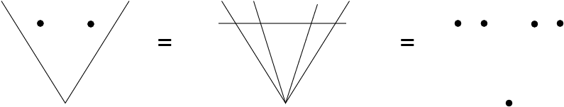
Last Time…
Direct Linear Transformation (DLT)
Inhomogeneous Solution
Degenerate Cases
Solutions from Lines and Points
x₁
x₄
x₁
x₁
x₂
H?
x₄
x₄
x₂
H’?
x₃
x₂
(case A)
x₃
(case B)
x₃

Slide 3
Today: Cost functions
Algebraic distance
Geometric distance
Reprojection error
Comparison
Geometric interpretation
Sampson error

Slide 4
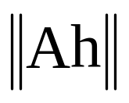

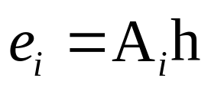
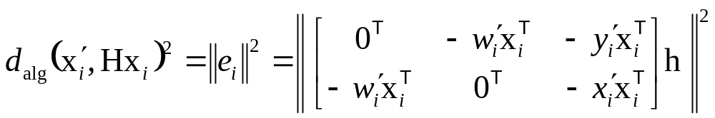
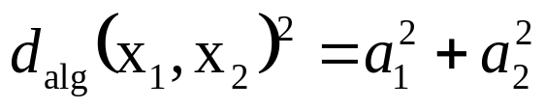
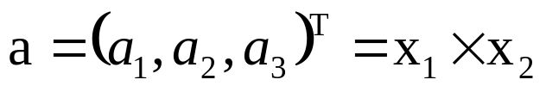
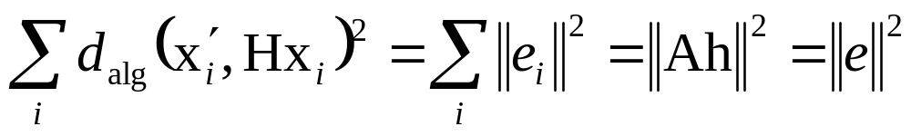
Algebraic distance
DLT minimizes
residual vector
partial vector for each (x_{i}↔x_{i}’)
algebraic error vector
algebraic distance
where
Not geometrically/statistically meaningfull, but given good normalization it works fine and is very fast (use for initialization)

Slide 5

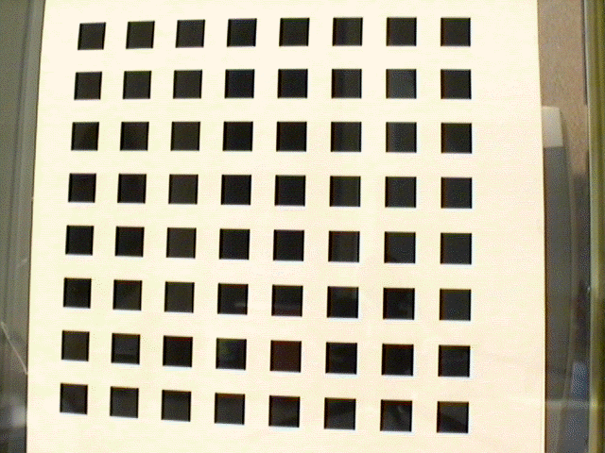


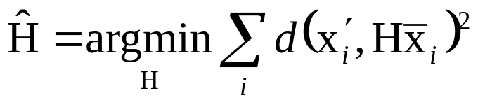
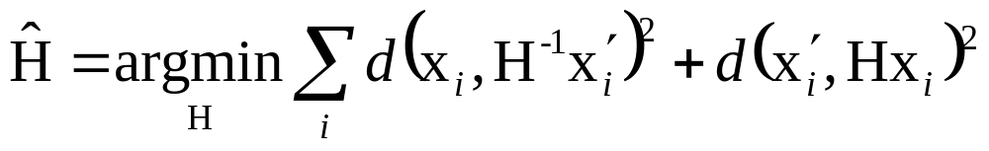
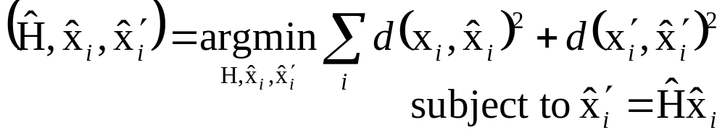
Geometric distance
measured coordinates
estimated coordinates
true coordinates
d(.,.) Euclidean distance (in image)
Error in one image
e.g. calibration pattern
Symmetric transfer error
Reprojection error

Slide 6
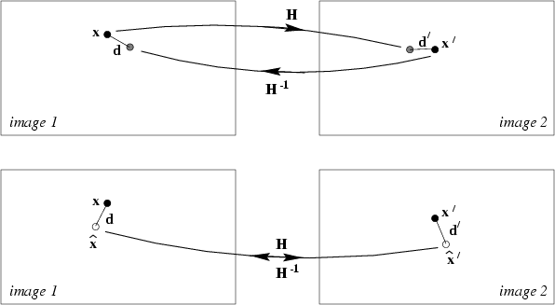
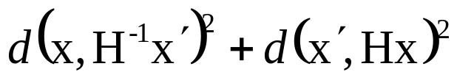
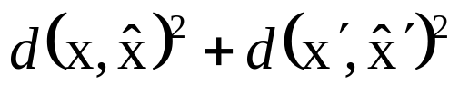
Reprojection error

Slide 7
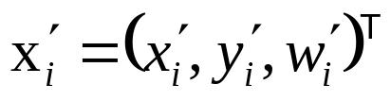
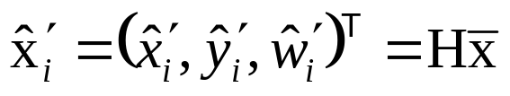
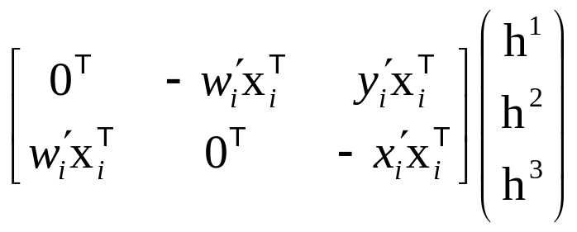
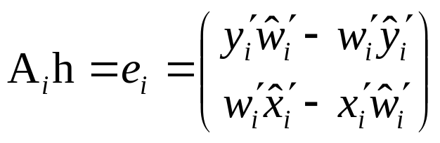
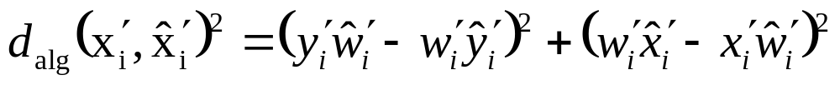
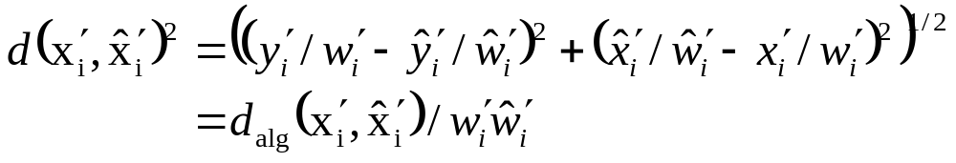


Comparison of geometric and algebraic distances
Error in one image
typical, but not , except for affinities
For affinities DLT can minimize geometric distance
Possibility for iterative algorithm

Slide 8


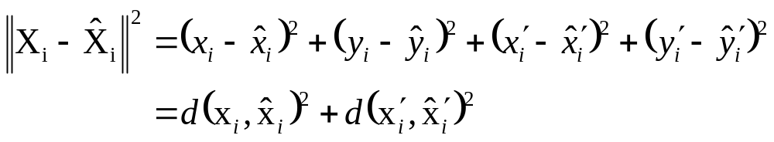

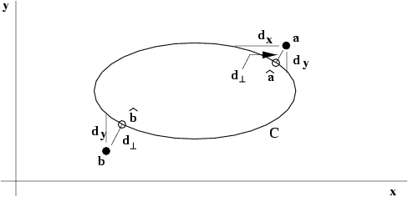


Geometric interpretation of reprojection error
Estimating homography ~ fit surface to points X=(x,y,x’,y’)^{T} in R⁴
represents 2 quadrics in R⁴ (quadratic in X)
Analog to conic fitting
Notes:
Nonlinear, except for line fitting = affine homographies (no quadratic terms in this case!) (x,x’,y and x,y,y’) => linear solution

Slide 9
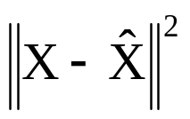




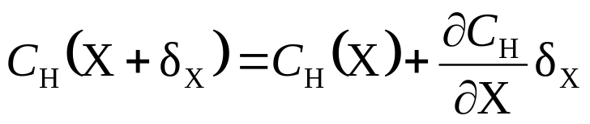


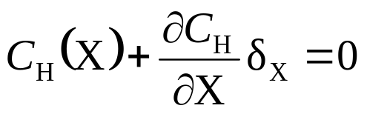
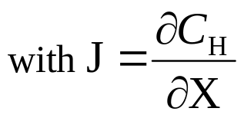



Sampson error
Between algebraic and geometric error
Vector that minimizes the geometric error is the closest point on the variety to the measurement
Sampson error: 1st order approximation of residual error
Find the vector that minimizes subject to

Slide 10





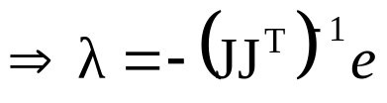
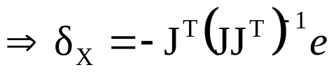

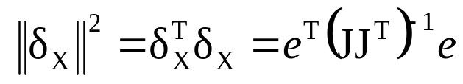
Find the vector that minimizes subject to
Use Lagrange multipliers:
minimize
derivatives

Slide 11
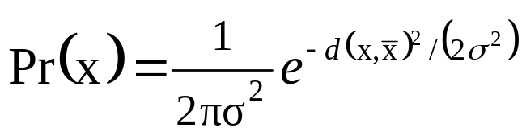
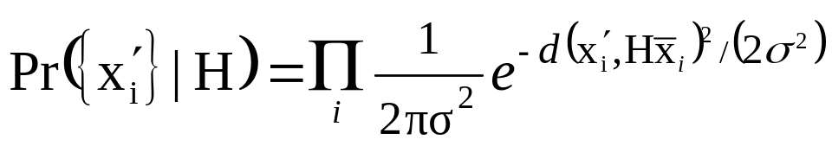
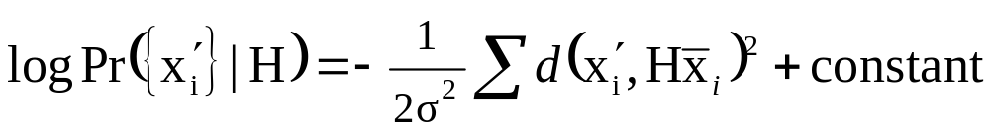
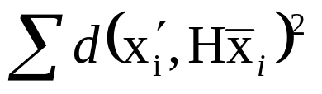
Statistical cost function and
Maximum Likelihood Estimation
Optimal cost function related to noise model
Assume zero-mean isotropic Gaussian noise (assume outliers removed)
Error in one image
Maximum Likelihood Estimate

Slide 12
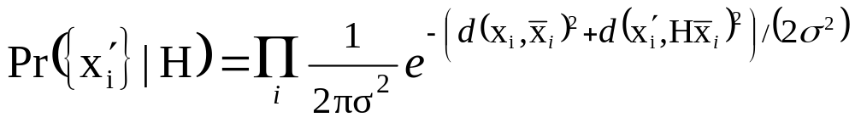
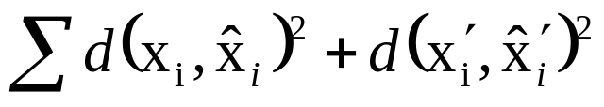
Statistical cost function and
Maximum Likelihood Estimation
Optimal cost function related to noise model
Assume zero-mean isotropic Gaussian noise (assume outliers removed)
Error in both images
Maximum Likelihood Estimate

Slide 13
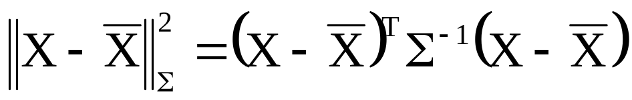
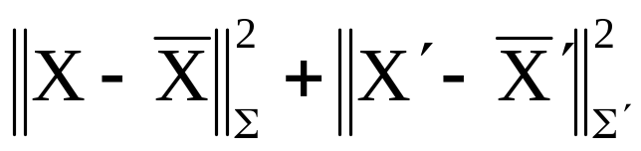
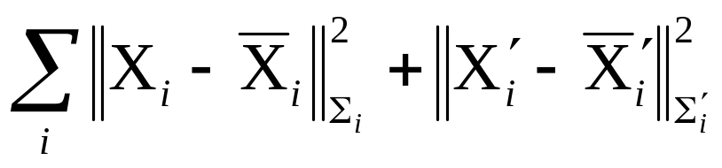
Mahalanobis distance
General Gaussian case
Measurement X with covariance matrix Σ
Error in two images (independent)
Varying covariances

Slide 14
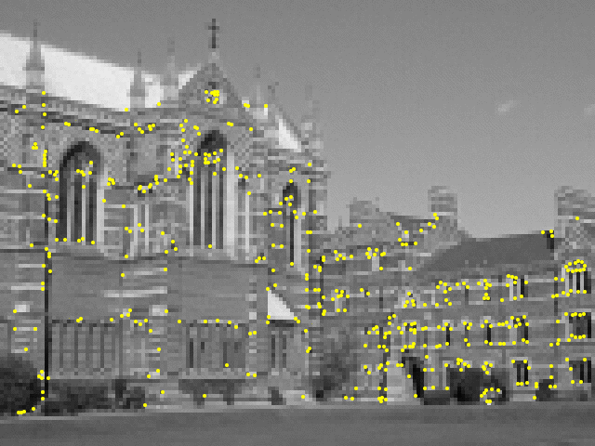
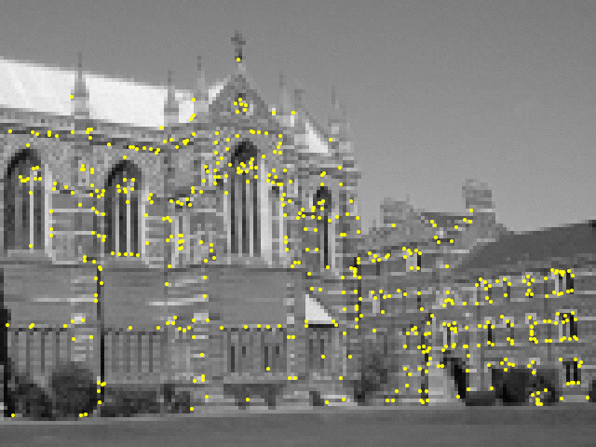
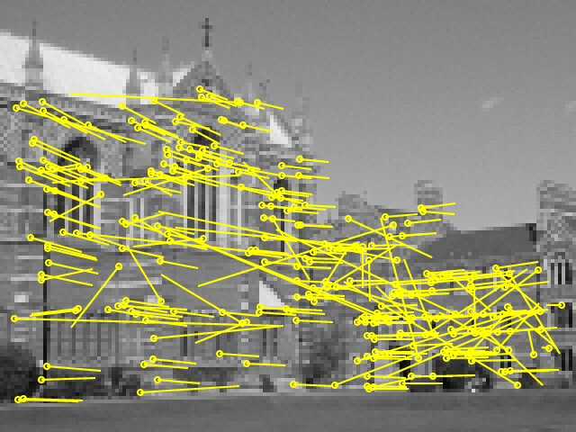
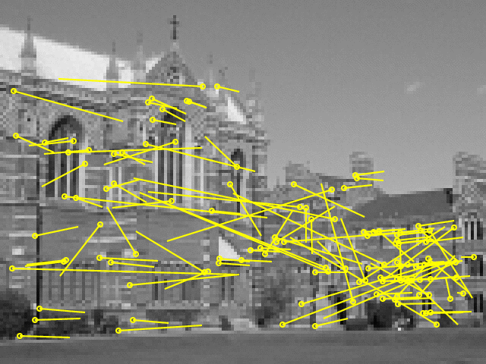
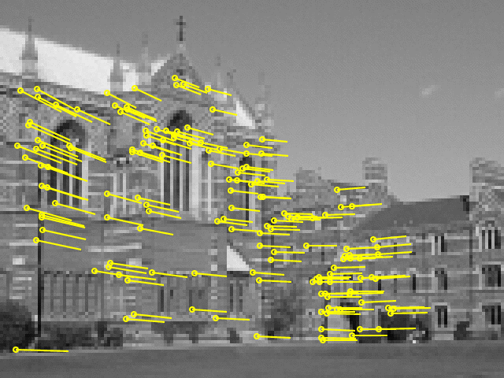
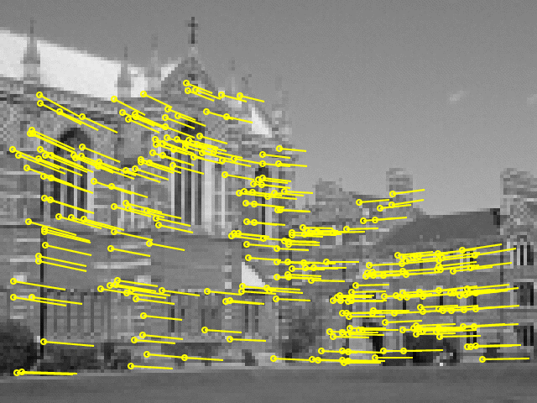
Next class: estimation (continued)
Transformation invariance
and normalization
Iterative minimization
Robust estimation

